Slide 1
Android Apps: Look and Feel
Module 6, Intro to I.T., Fall 2011
Sam Scott

Slide 2
Goals of This Module
Learn to use Google AppInventor.
Create simple Apps that respond to button presses and other events.
Build a Tic Tac Toe front end, possibly using a variable and a simple if statement.

Slide 3
Goals of the Next Module
Create more complex Apps.
Use different events.
Learn how to program more complex logic.
Turn the Tic Tac Toe front end into a working App

Slide 4
Evaluation for This Module
In class exercises
3 marks
Tic Tac Toe project
10 marks

Slide 5
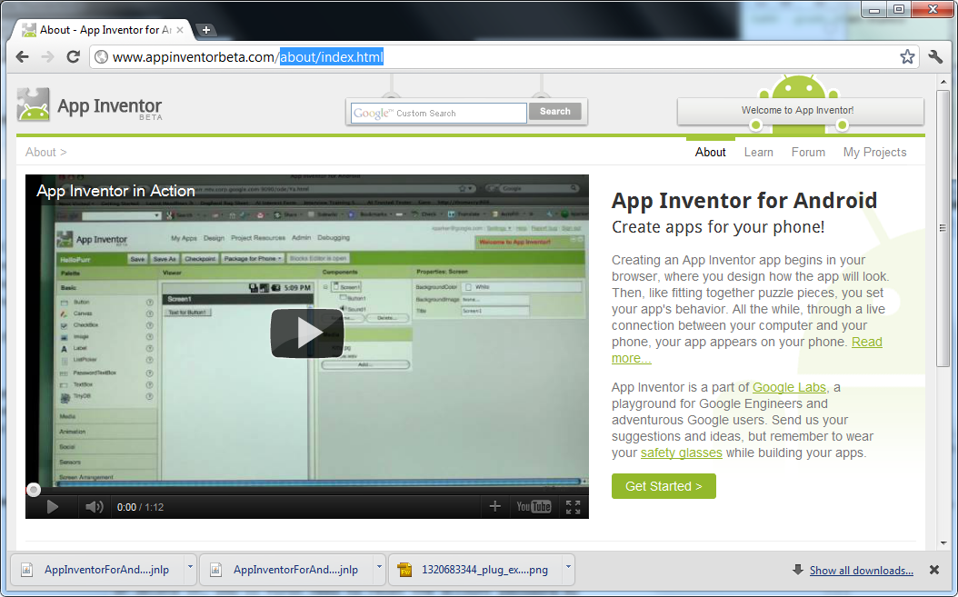
Getting Set Up
Sign up for a google account
Download the Google Chrome browser and run it.
Go to www.appinventorbeta.com and click Get Started
Then click “Set Up Your
Computer”, “Instructions
for Windows”,
“Download the
installer”, and follow
the instructions

Slide 6
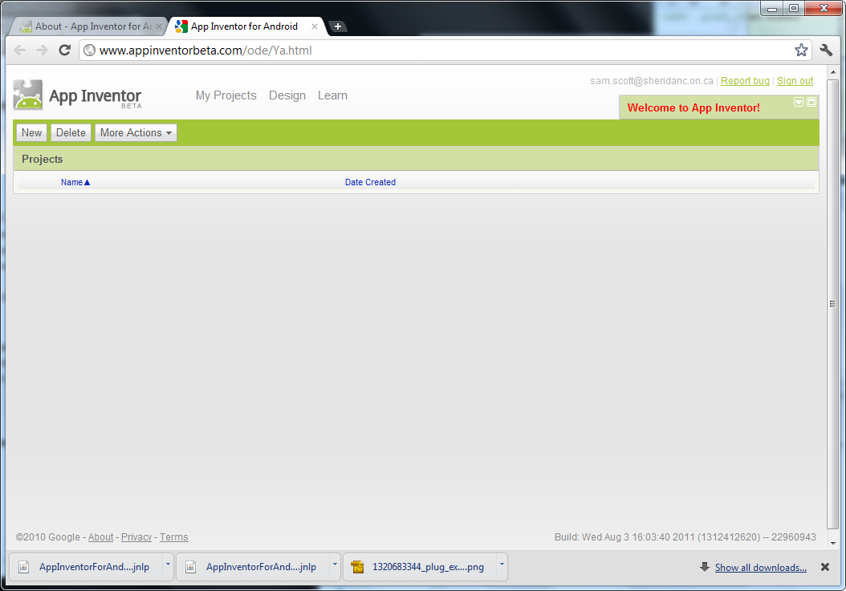
Getting Set Up
Then go to “My Projects”…

Slide 7
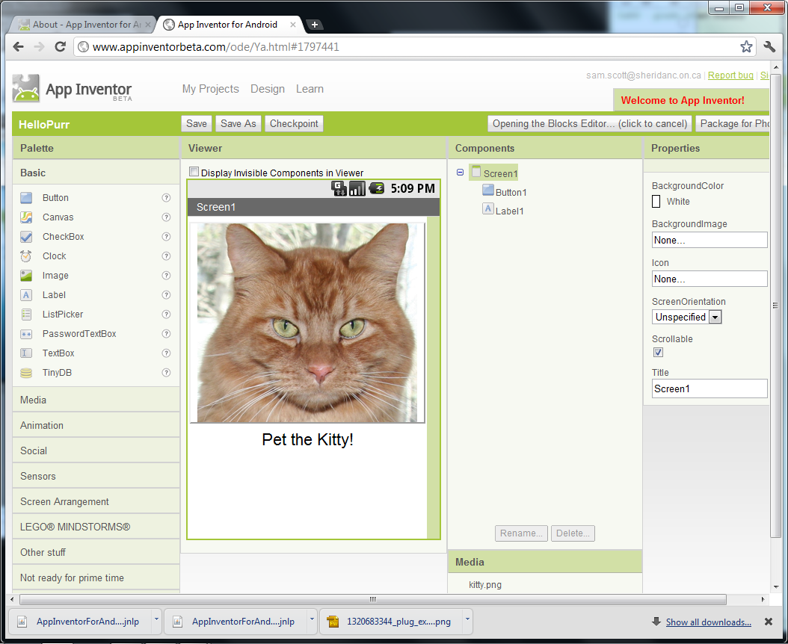
The Project Window
Lay out your App’s interface here.
Click here to get to the Blocks Editor.
This step will download a .jnlp file which you should “keep” and “open”. If the automatic opening on Chrome doesn’t work, you will have to find the file in your downloads folder and launch it from there.

Slide 8
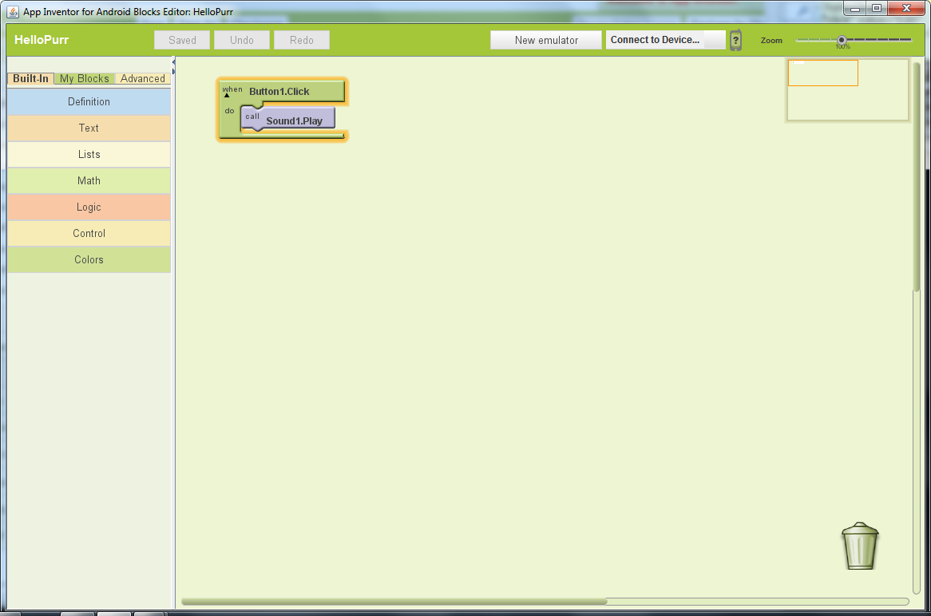
The Blocks Editor
Program your App’s behaviours and logic here.
Click here to start the emulator if you don’t have a phone.

Slide 9
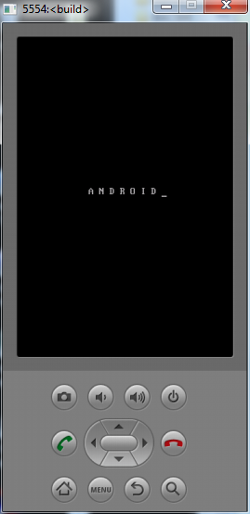
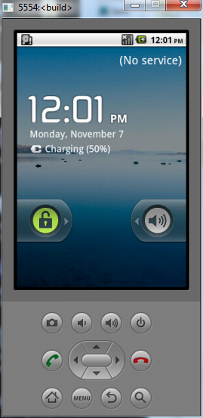
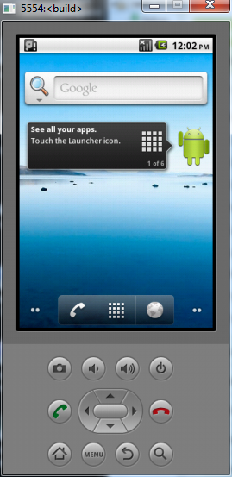
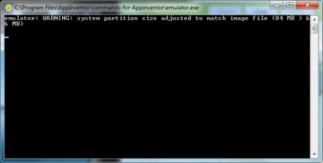
The Emulator (if no real phone)
This is where you test your App.
Wait for it to boot, then unlock the phone and get to this screen before you try to connect.
Just ignore this window. But don’t close it or the emulator will crash.

Slide 10
Connect to the Phone
Click here in the blocks editor to connect to the phone (whether it’s real or an emulator).

Slide 11
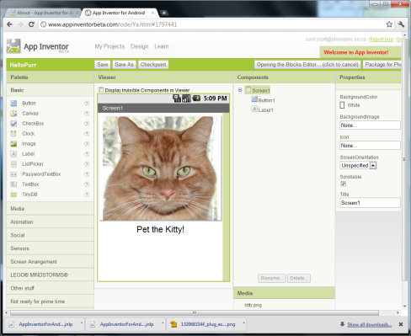

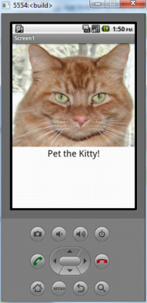
The Three Development Windows
Launches
Google Chrome
Java Program (.jnlp)
Launches
Talks to
Talks to
Emulator

Slide 12
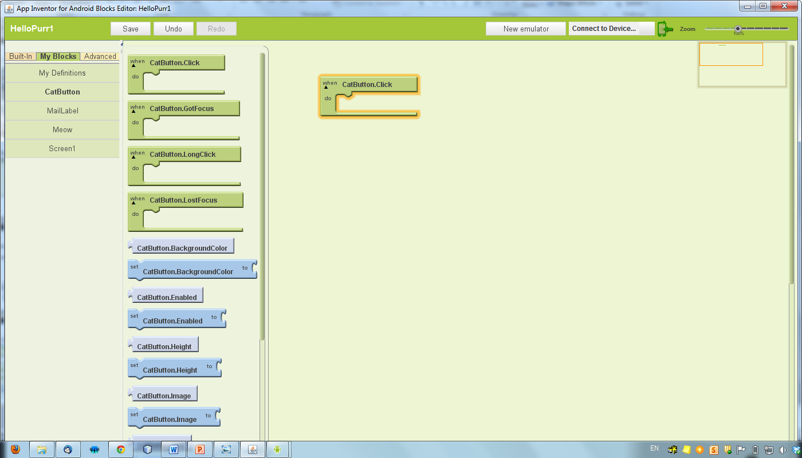
Event-Driven Programming
Whenever it is clicked
(generating a “click event”),
The phone will do whatever
you tell it to do in here.
The cat is a button

Slide 13
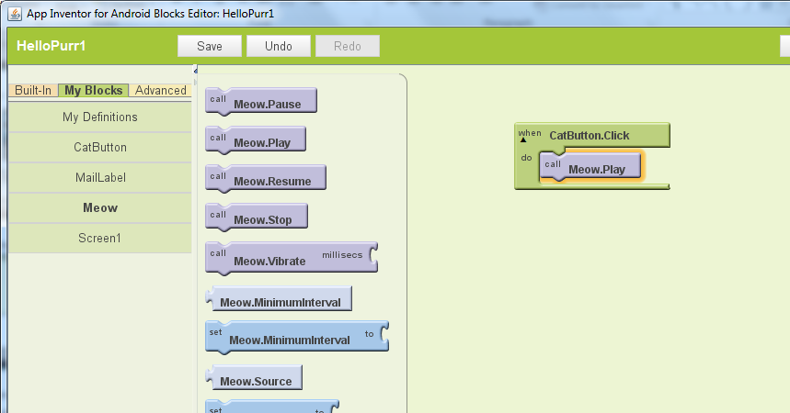
Event-Driven Programming
Now when the cat button
is clicked, the Meow sound
will play. You can add as
many actions as you like to
this click event.
The meow is a sound
object that can be
played.

Slide 14
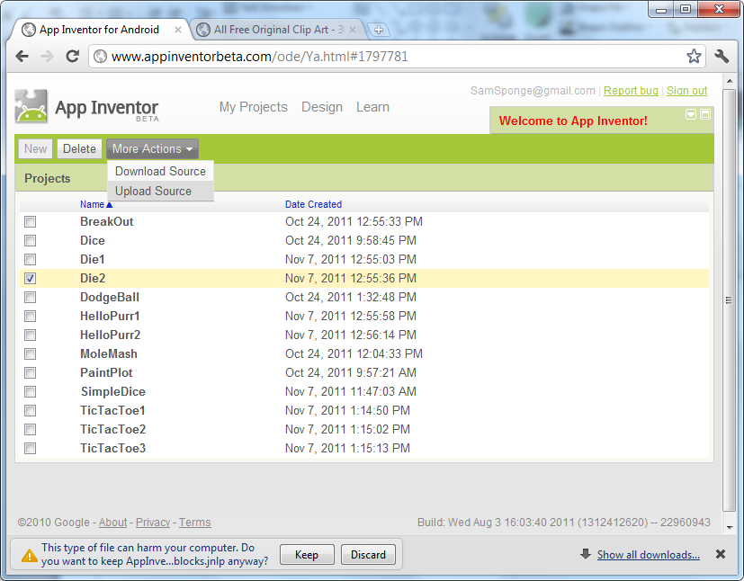
Saving and Loading Projects
In the Projects window, click “My Projects”. Here you can download your project to a zip file or upload a zipped project.
You can also create new projects and delete old ones here.

Slide 15
Useful Links
Tutorials and Software
http://www.appinventorbeta.com/about/
Free Sounds
http://www.freesound.org/
http://www.findsounds.com/
Free Images
http://search.creativecommons.org/
http://www.free-graphics.com/

